Slide 2
PART 2. EQUIFAX
2.1 Background information and basic assumption
Equifax gives credit scores to companies and individuals
Higher Equifax score should suggest better payment behavior
Equifax is a global data, analytics, and technology company known for providing information solutions and analytics to businesses and consumers. In Chile, Equifax operates as a credit reporting agency, offering credit information and risk management services to financial institutions, businesses, and consumers. The score is usually between 280 to 850, and the basic interpretation is as follows:
Our key assumption for exploring with the Equifax score is that individuals with a higher Equifax score should be a more motivated payer. By saying that, we expect individuals with higher Equifax scores to have a higher probability of making payment (or, individuals making the payment should tend to have a higher score than individuals who don’t), to have a shorter delay in making payments, and to make a larger amount of payment.
To justify our assumptions, we first carried our EDA on the consolidated dataset, so as to visualize the pattern of the relationships between Equifax score and the variables we care about. If the pattern generally coincides with our assumption, we will then further carry out tests to quantify the relationship.
300 - 579 | POOR
580-669 | FAIR
670-739 | GOOD
740-799 | VERY GOOD
800+ | EXCELLENT
Howard Yu

Slide 3
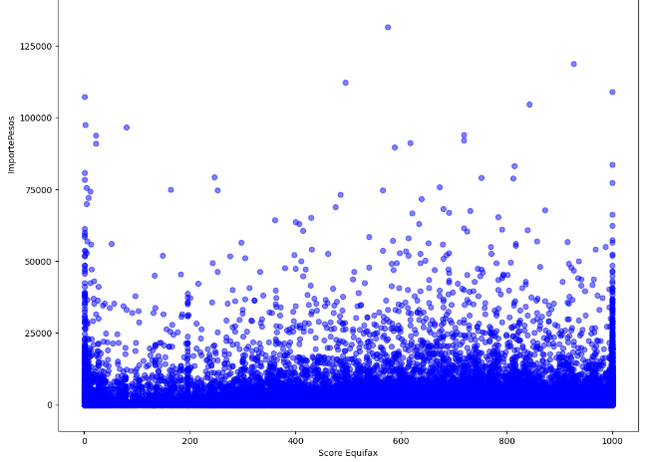
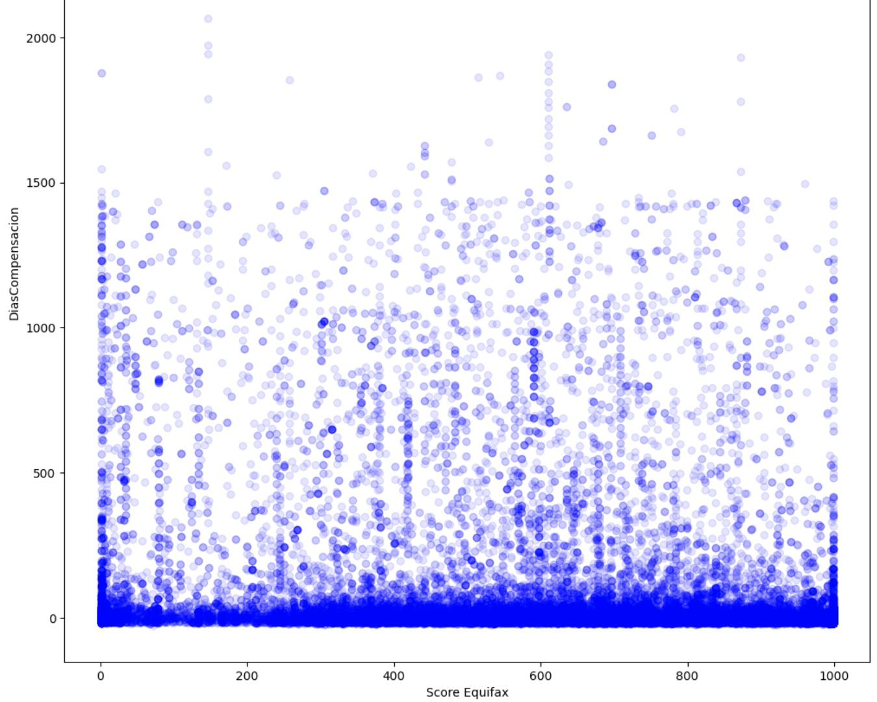
PART 2. EQUIFAX
2.2.1 Equifax Score vs ImportePesos
2.2.2 Equifax Score vs DiasCompensacion
DiasCompensacion is the variable showing the difference between the due date and the payment date. As shown in the graph, there isn’t a significant relationship between the DiasCompensacion and the Equifax score. Unlike what we would have expected, for each Equifax score, the DiasCompensacion has shown a similar pattern, which is covering a range from 0 to nearly 1500, while mostly concentrating in number of days below 100. A possible explanation for this phenomenon is that the DiasCompensacion is only recorded for individuals who have actually made payment, and for those who make payments, they tend to finish the payment within 100 days regardless of their Equifax score.
ImportePesos is the variable recording the transaction amount. Again, unlike what we have expected, the relationship between the ImportePesos and the Equifax Score doesn’t seem to be significant. For each Equifax Score, the transaction amount covers a similar range, while the majority of transactions locate below 25000 pesos. [Normal range of transaction fee amount?]
Howard Yu

Slide 4
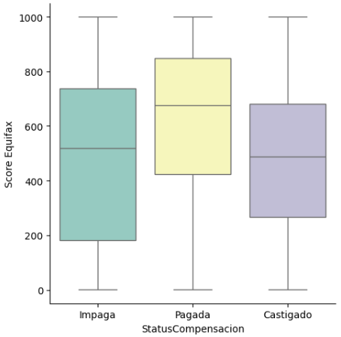
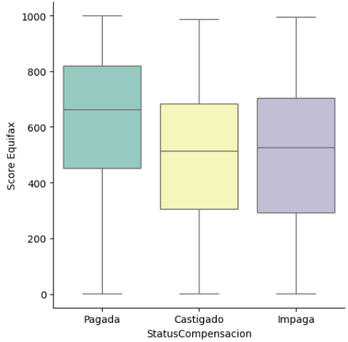


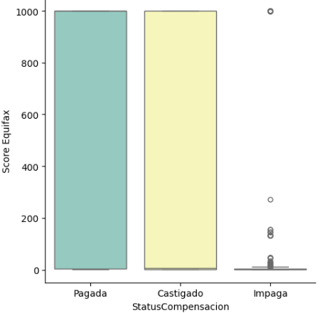

PART 2. EQUIFAX
2.2.3 Equifax Score vs Status Compensacion
General Trend
Natural Individuals
Legal Individuals
Status Compensacion is the variable recording the payment status, which includes Pagada(paid), Impaga(unpaid), and Castigado(unpaid write-off). From the boxplot, we can tell that the Pagada group has an apparently higher median than other two groups, and the range is generally higher as well. Taking a closer look into the group mean, we noticed that the Pagada group has a significantly higher average Equifax score than the other two groups. All these findings coincide with our initial hypothesis, that individuals making payment should have a higher Equifax score than those who don’t, and thus we wish to further quantify the relationship between Equifax Score and Status Compensacion
Howard Yu

Slide 5
PART 2. EQUIFAX
2.3 Quantitative analysis on 2.2.3
Howard Yu

